Slide 1

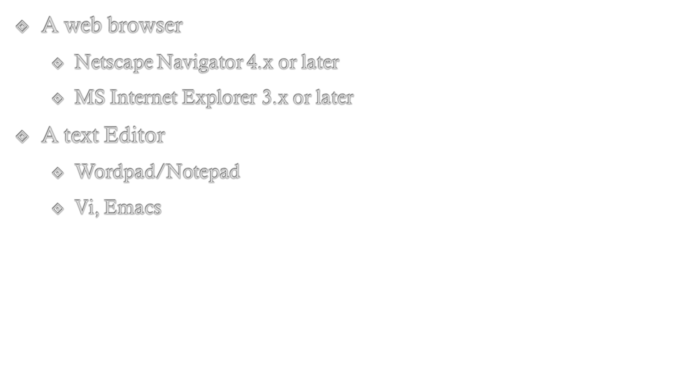

Slide 2

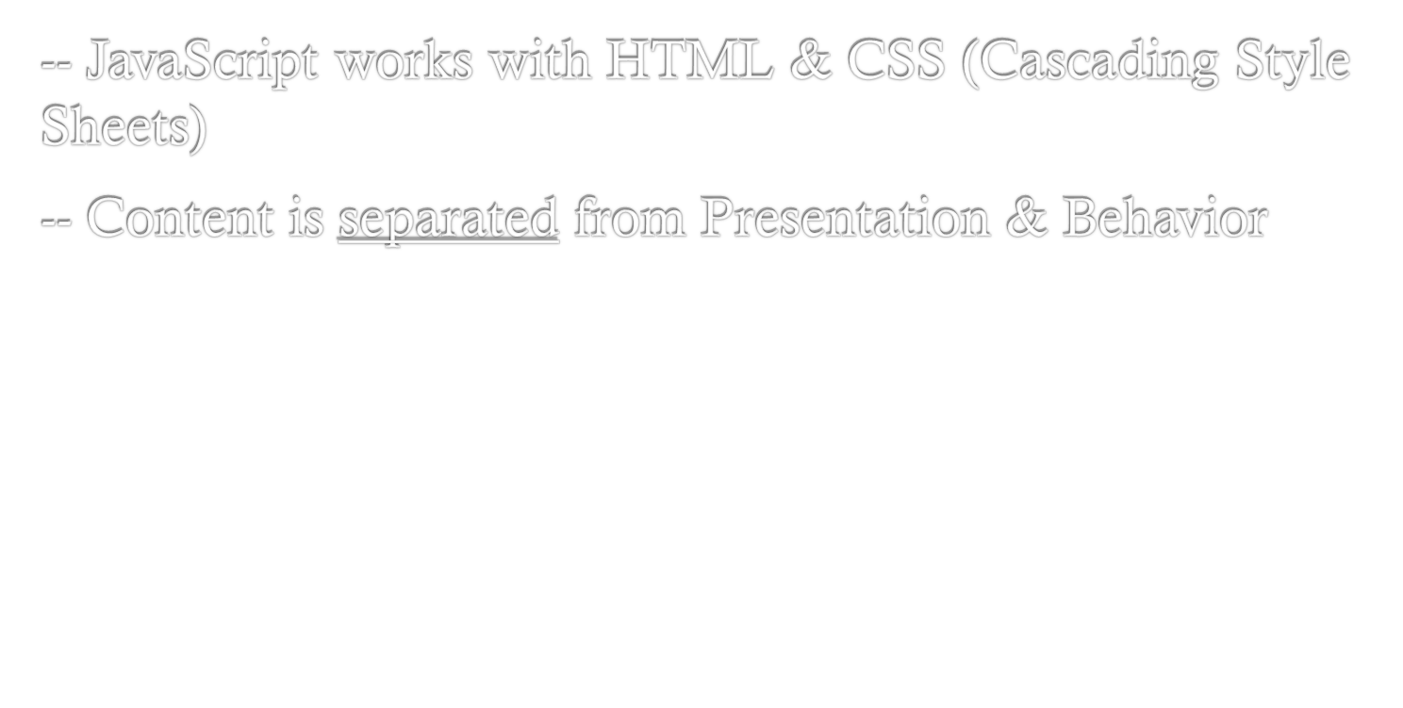
HTML
Content
CSS
(Cascading Style Sheets)
Presentation
JavaScript
Behavior

Slide 3

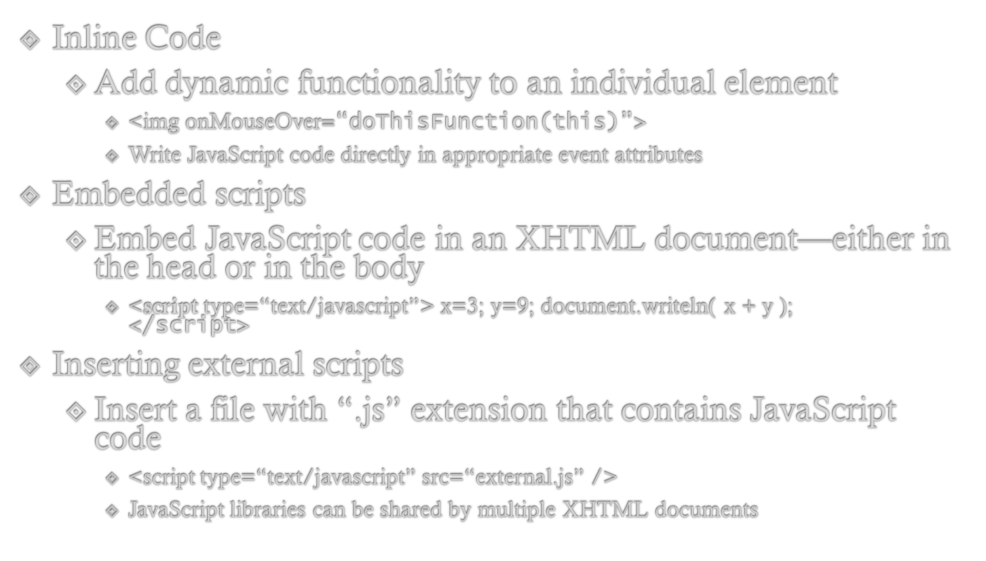

Slide 4

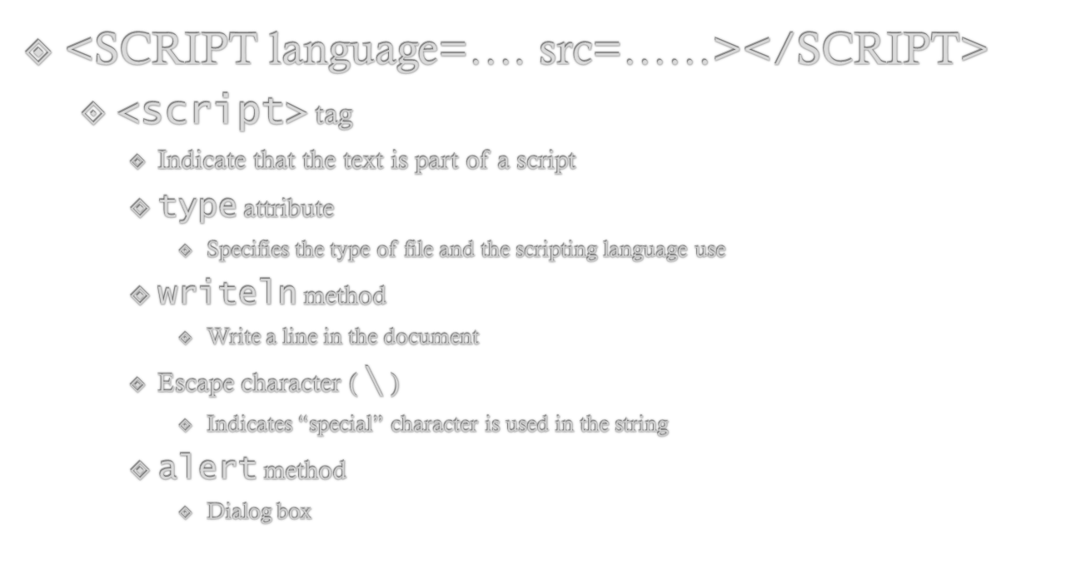

Slide 5

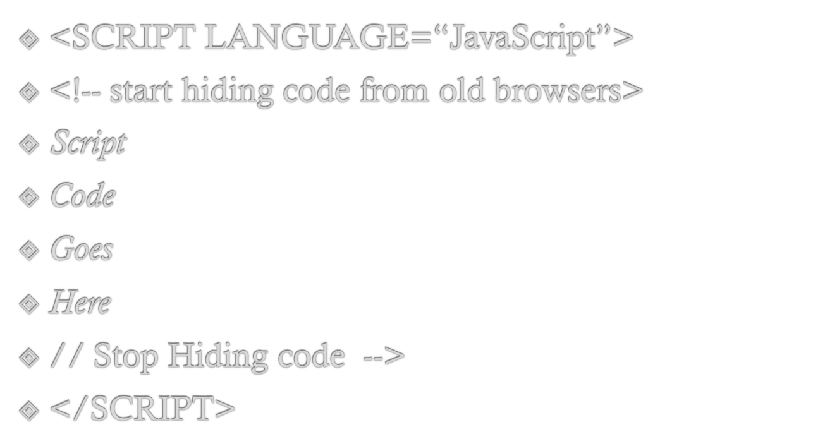

Slide 6

External JavaScript File
<body>
...
<script type="text/javascript" src=“myCode.js" />
<script type="text/javascript">
//<![CDATA[
alert("Page is loading");
//]]>
</script>
<p onclick="alert('I told you not to click on me!');">
Please do not click on this text.</p>
...
</body>
Inline Code
Event Handler

Slide 7

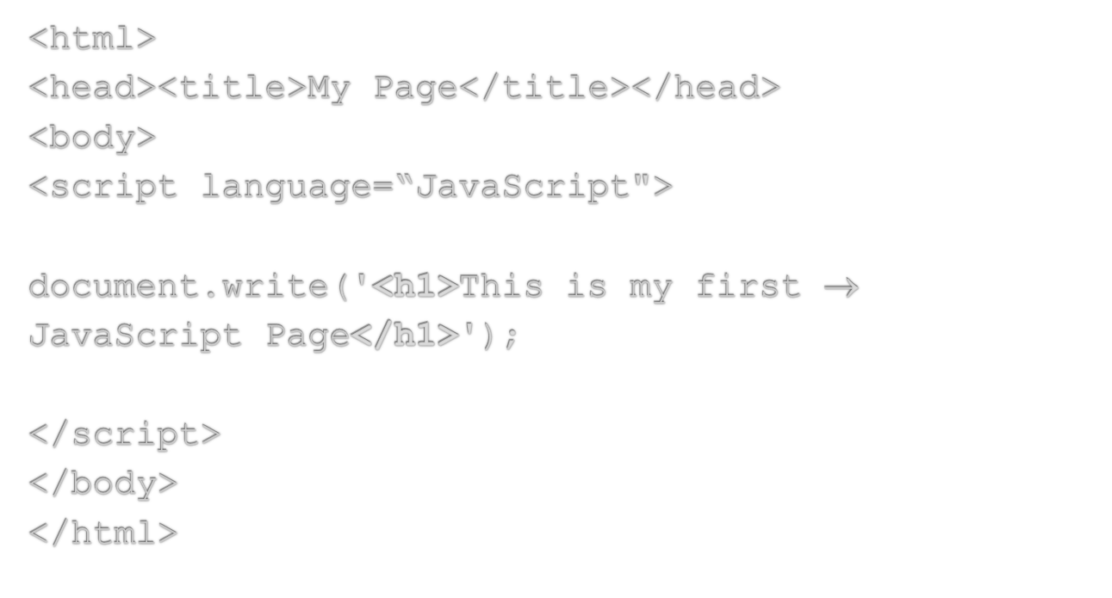
HTML written
inside JavaScript
Notes:
This example demonstrates that anything included within the quotes in the document.write statement is printed to the screen, and this includes HTML tags. The <h1> tag is delivered to the browser along with the text, and the browser would interpret it as a normal HTML file, displaying the text in the Heading 1 style.
IMPORTANT NOTE:
This example shows a JavaScript statement in the <body> of the web page.
It is possible to include JavaScript statements in the <head> section of a web page but care must be taken that they do not try to access items that don't exist until the page has loaded (e.g. form elements, links, images). The web browser parses (reads through and executes) any script commands as it displays the page.
In most cases it is common sense that dictates where a statement should be placed.
If, in the above example, document.write was placed in the <head> of the page, the text "This is my first JavaScript Page" would appear in the <head> of the finished page – this would be incorrect – although modern browsers will let you get away with it!
In some circumstances you may wish to use document.write in the <head> - for example to dynamically generate <meta> or <title> tags. Such uses are not considered here.
JavaScript functions are typically defined in the <head> section of a web page as they do not normally execute until they have been triggered elsewhere. The use of functions in JavaScript is covered in the Netskills Training Module: "Further JavaScript (Enhancing JavaScript with Functions and Events)"

Slide 8
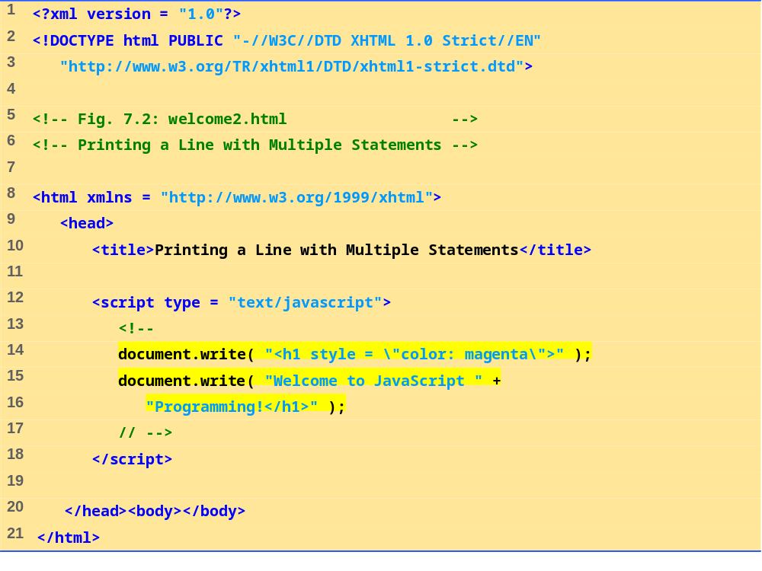

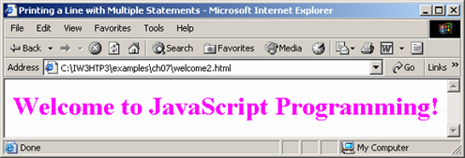

Slide 9

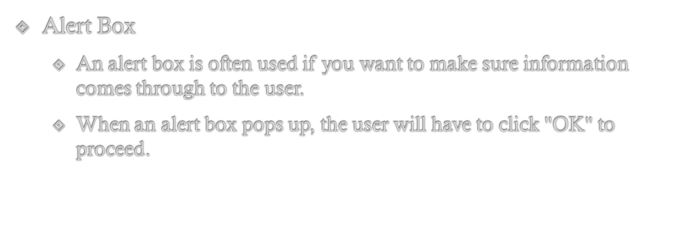
<head>
<script language=“JavaScript”>
alert(“An alert triggered by JavaScript”);
</script>
</head>

Slide 10

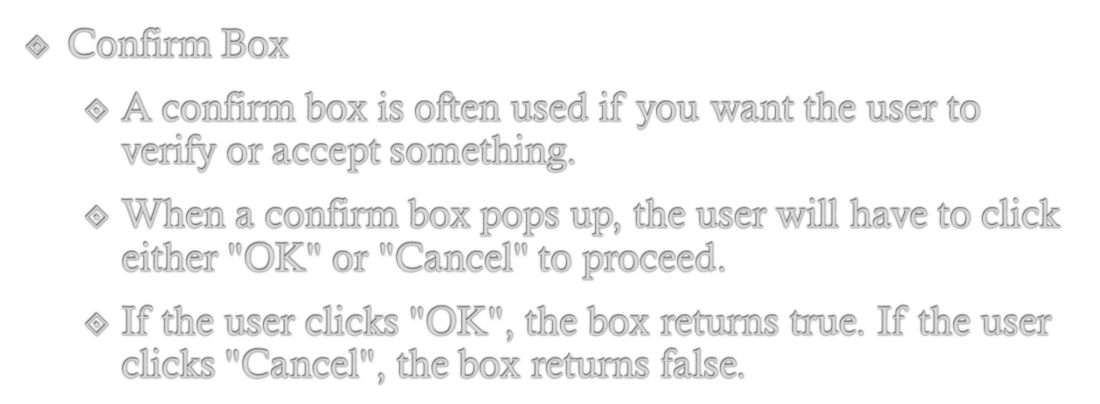
<head>
<script language=“JavaScript”>
confirm(“Are you happy with the class?”);
</script>
</head>

Slide 11

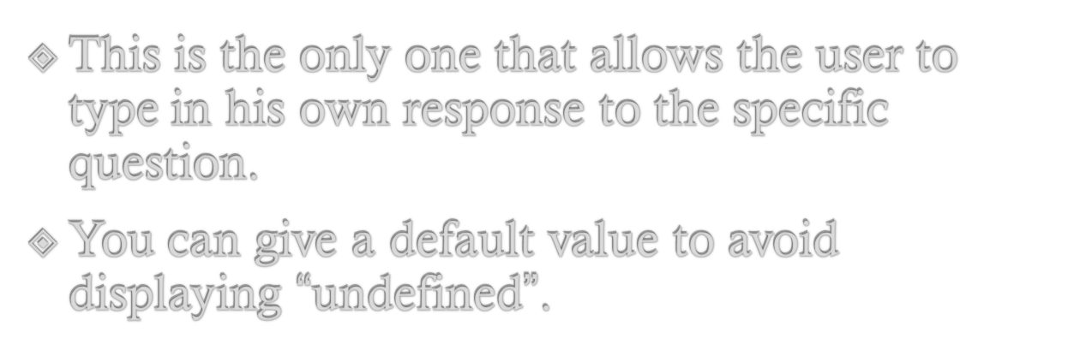
<head>
<script language=“JavaScript”>
prompt(“What is your student id number?”);
prompt(“What is your name?”,”No name”);
</script>
</head>

Slide 12

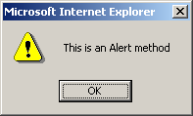

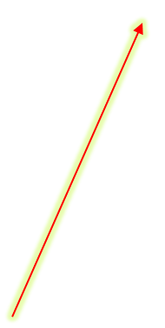
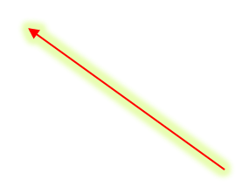
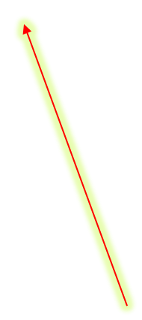
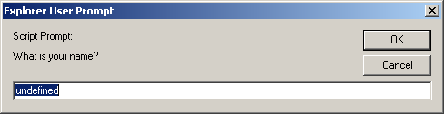
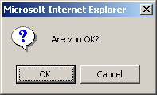
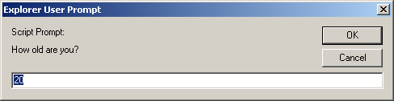
<script language="JavaScript">
alert("This is an Alert method");
confirm("Are you OK?");
prompt("What is your name?");
prompt("How old are you?","20");
</script>

Slide 13
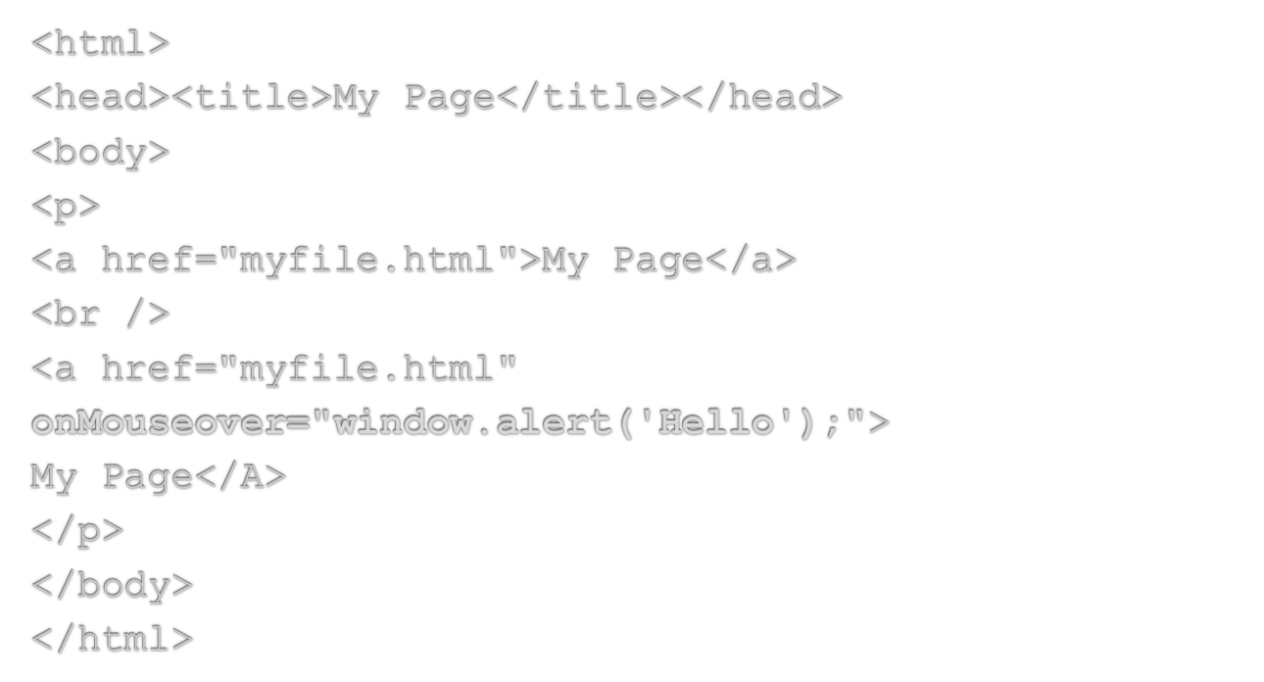
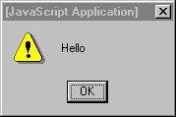



JavaScript written
inside HTML
An Event

Slide 14
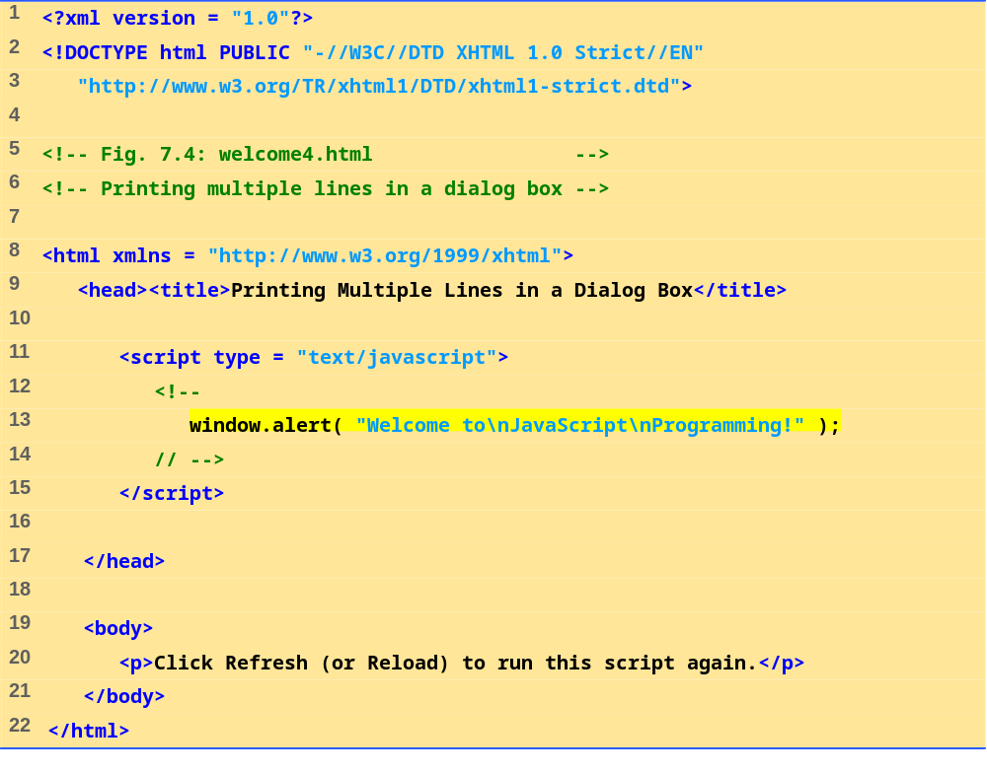

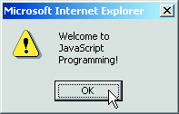
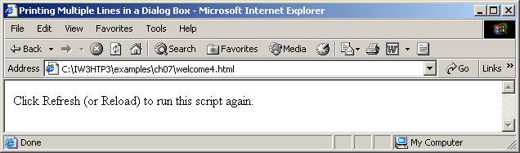

Slide 15

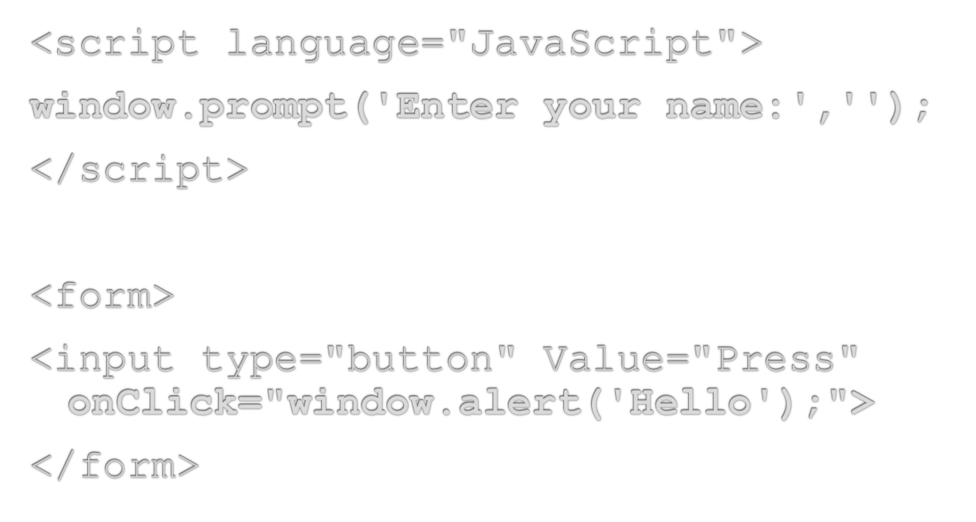
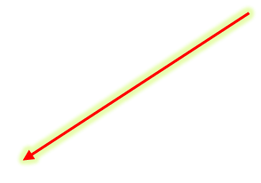
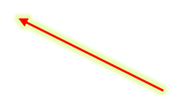

Another event
Note quotes: " and '

Slide 16

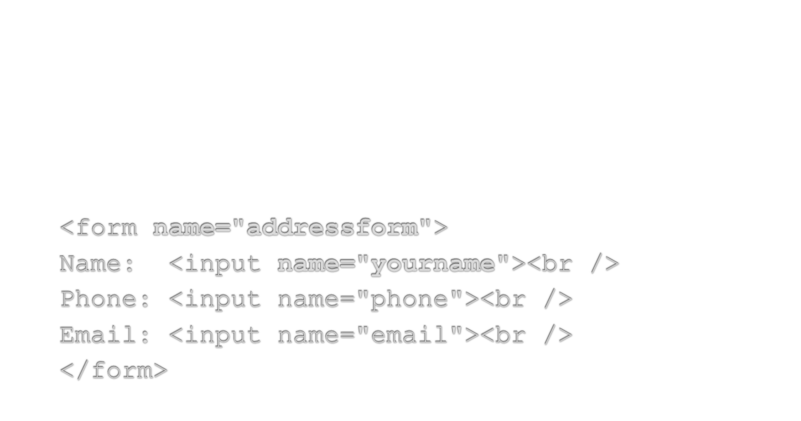

Notes:
This example shows a simple form. Notice the name attribute is used at all points - to name the form, and to name each element within the form.
How JavaScript uses the name attribute is described next.

Slide 17

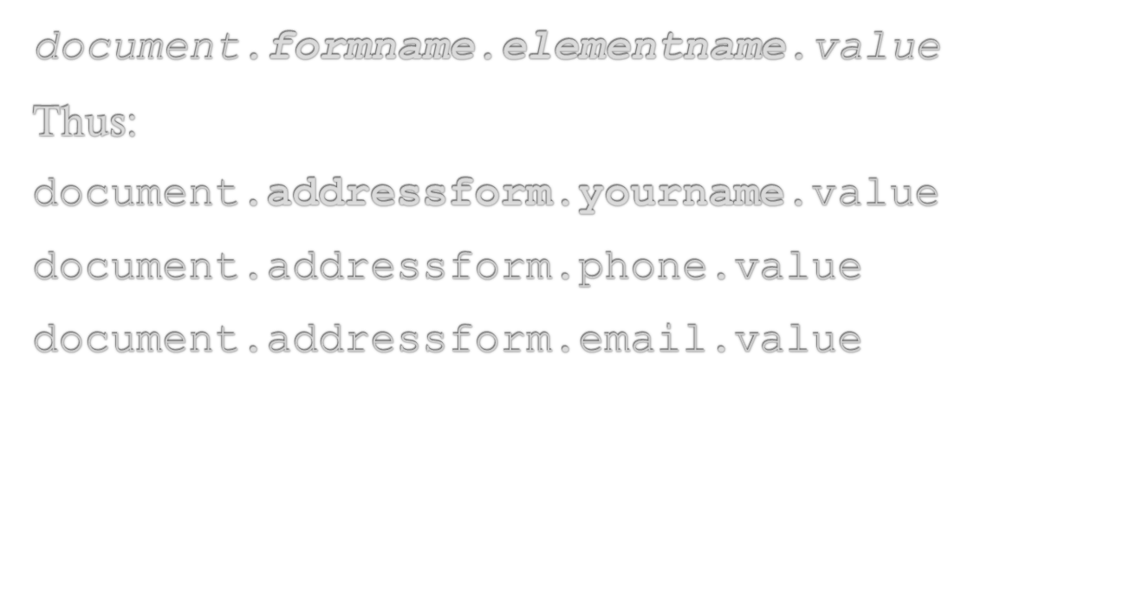



Notes:
To refer to the value that a user has typed in a text box, you use the following naming system:
document.formname.elementname.value
This is a naming convention derived from the JavaScript object model:
document refers to the page displayed in the browser.
formname is supplied by the page author as the name attribute of the <form> tag - in the example it is addressform and refers to the whole form.
elementname is supplied by the page author using the name attribute of the <input> tag.
value is a predefined term which refers to the text typed in by the user.

Slide 18

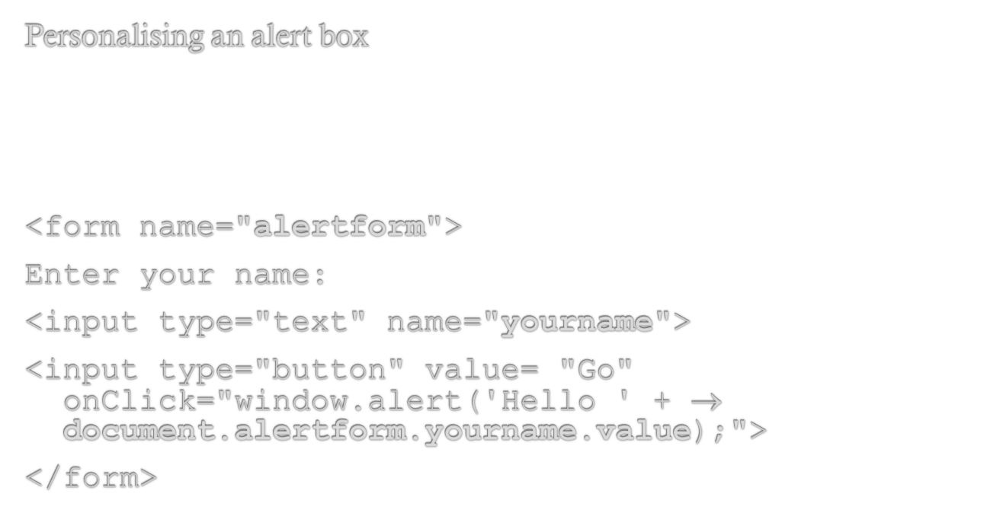
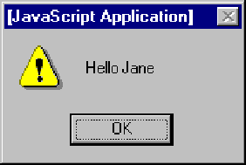

Notes:
This simple code creates a form called alertform.
The JavaScript is activated when 'Go' button is pressed (an onClick event - see separate Netskills Training Module for more details on Functions and Events in JavaScript). The current value of the element yourname would be displayed in a an alert box.

Slide 19
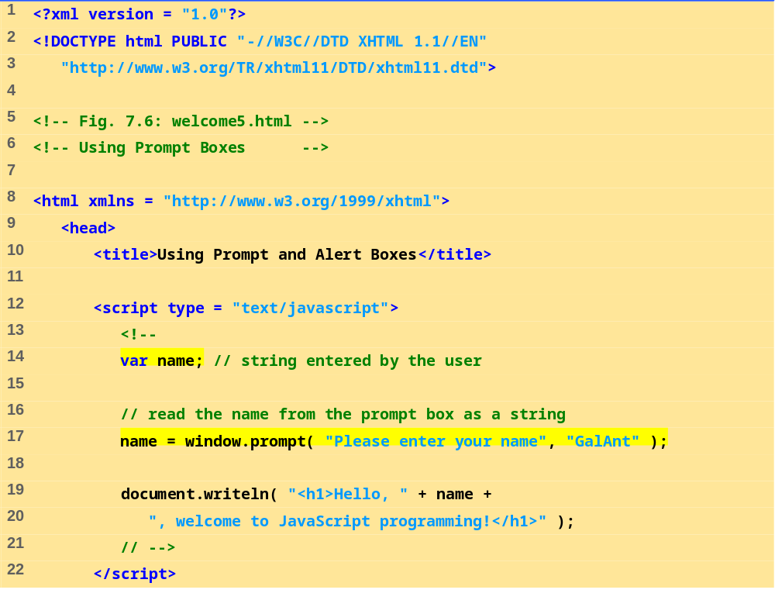

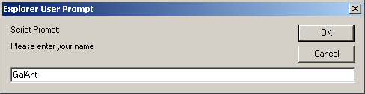
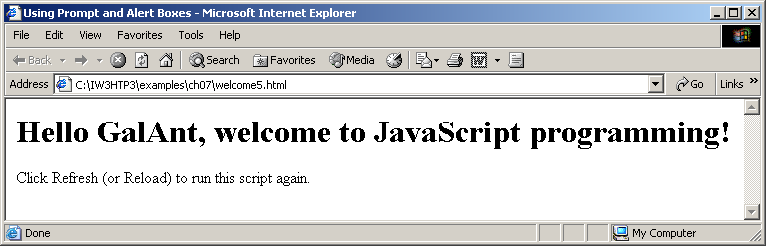
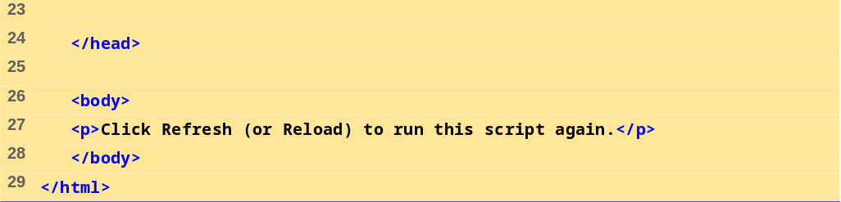

Slide 20





When the user clicks OK, the value typed by the user is returned to the program as a string.
This is the prompt
to the user.
This is the default value that appears when the dialog opens.
This is the text field in which the user types the value.
Fig.:Prompt dialog displayed by the window object’s prompt method.

Slide 21
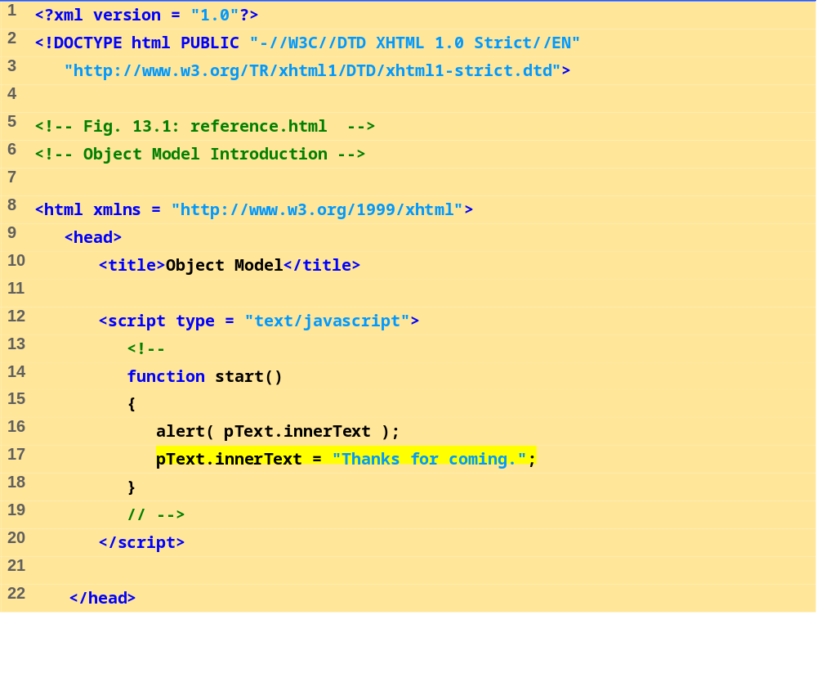
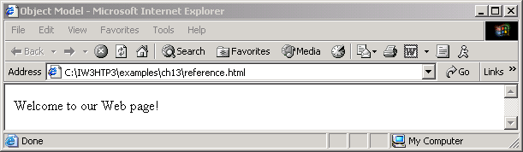
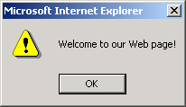
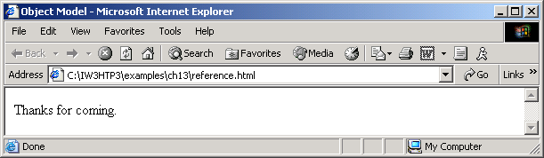
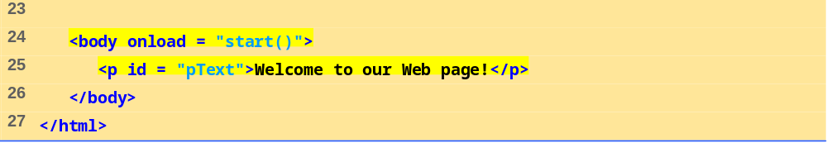

Slide 22
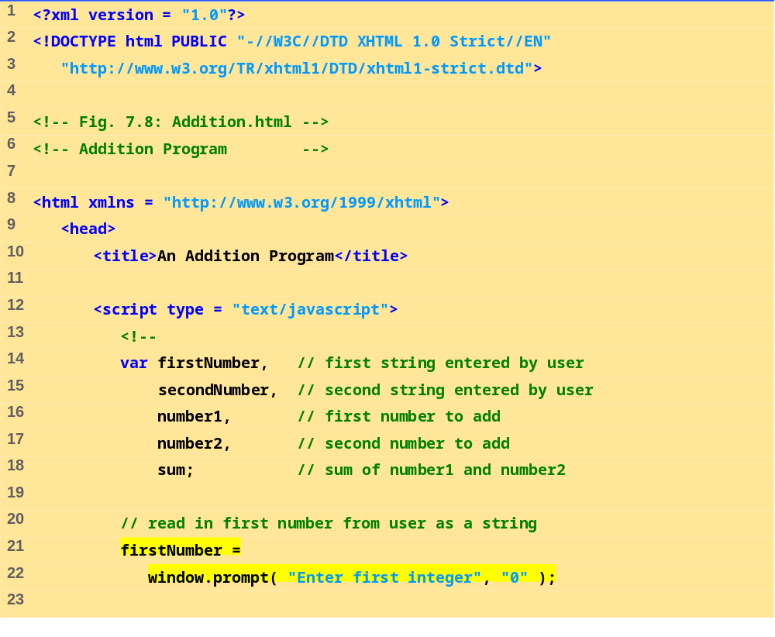
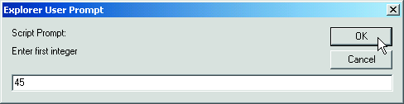

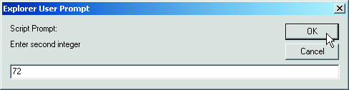
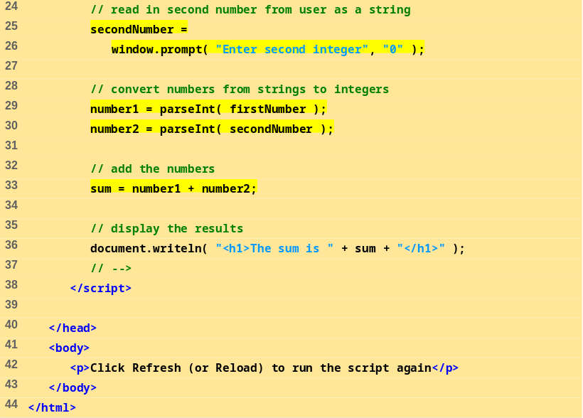
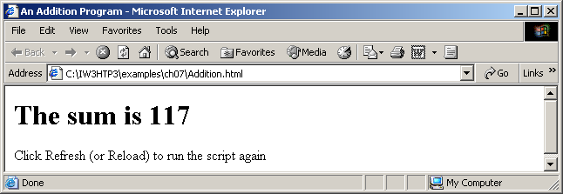

Slide 23

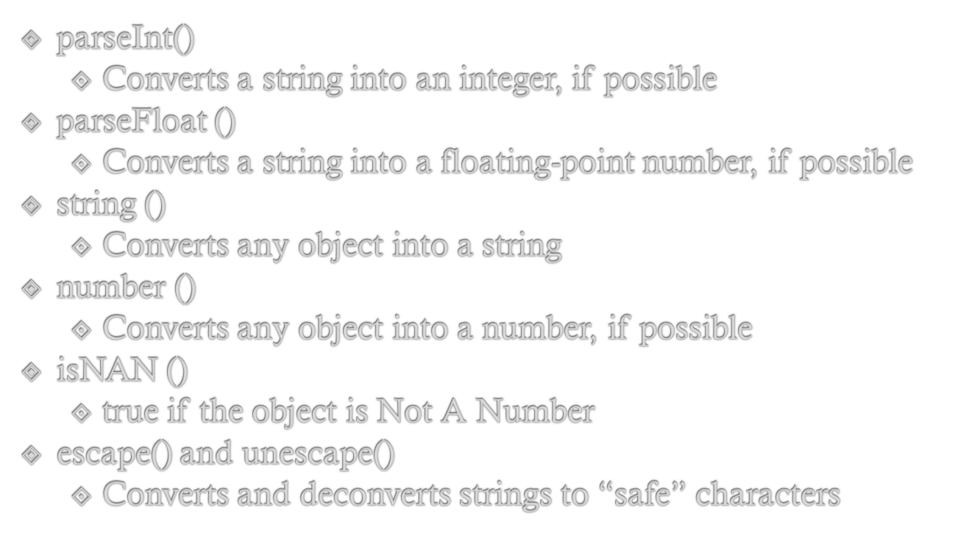

Slide 24
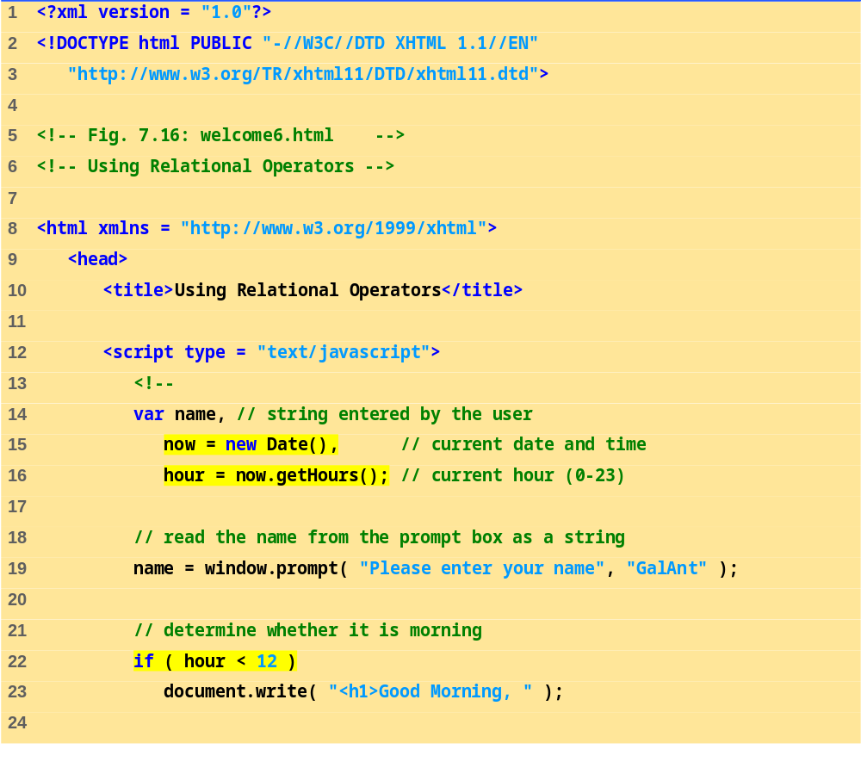


Slide 25
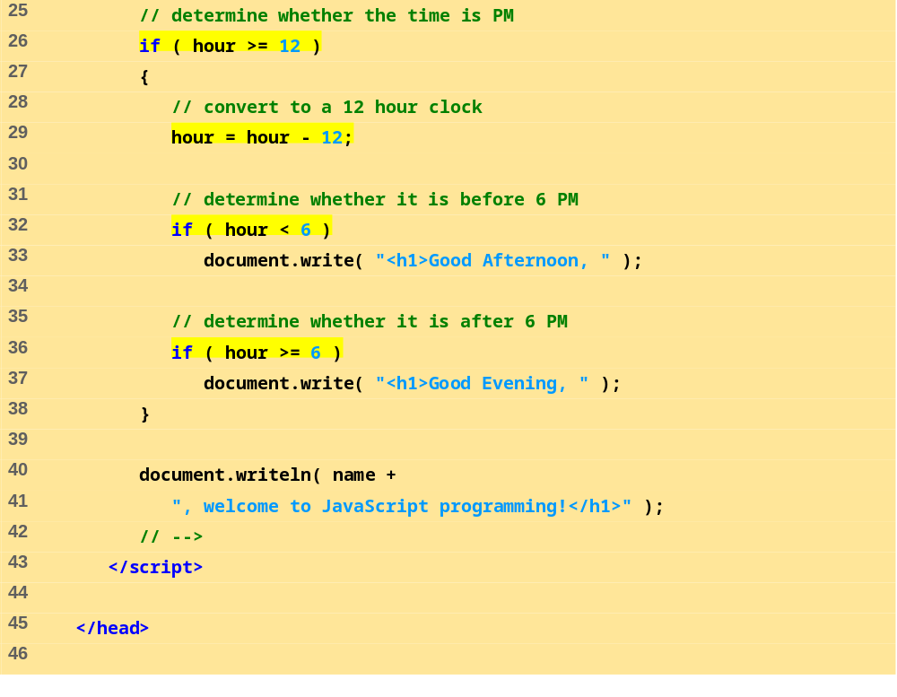
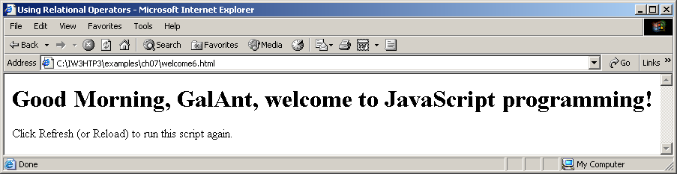
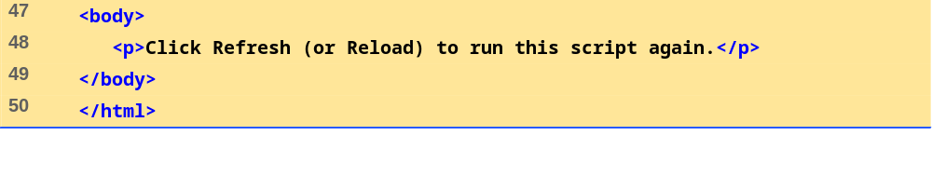

Slide 26
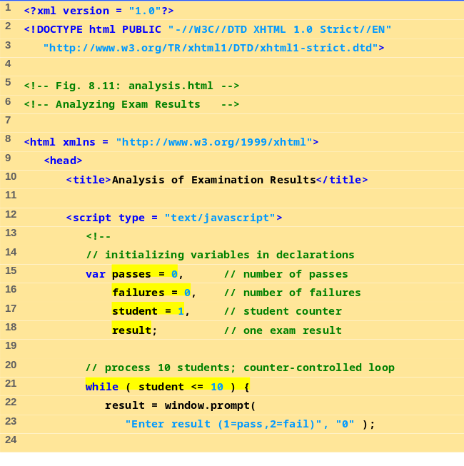



Slide 27




Slide 28





Slide 29




Slide 30




Slide 31




Slide 32





Slide 33



Slide 34










Slide 35





Slide 36





Slide 37





Slide 38

Element’s style can be changed dynamically
Dynamic HTML Object Model also allows you to change the class attribute

Slide 39





Outline
dynamicstyle.html
(1 of 2)

Slide 40





Outline
dynamicstyle2.html
(1 of 2)

Slide 41

XHTML elements can be positioned with scripting
  Declare an element’s CSS position property to be either absolute or relative
  Move the element by manipulating any of the top, left, right or bottom CSS properties

Slide 42






Outline

Slide 43

Referencing elements and objects in different frames by using the frames collection

Slide 44



Outline

Slide 45




Slide 46

Netscape, Mozilla, Microsoft’s Internet Explorer
  Others as well
Contains information about the Web browser
Allows Web authors to determine what browser the user is using

Slide 47




Outline
navigator.html
(1 of 2)

Slide 48



Slide 49


Slide 50


Slide 51


Slide 52


Slide 53


Slide 54


Slide 55



Slide 56



